Slide 1
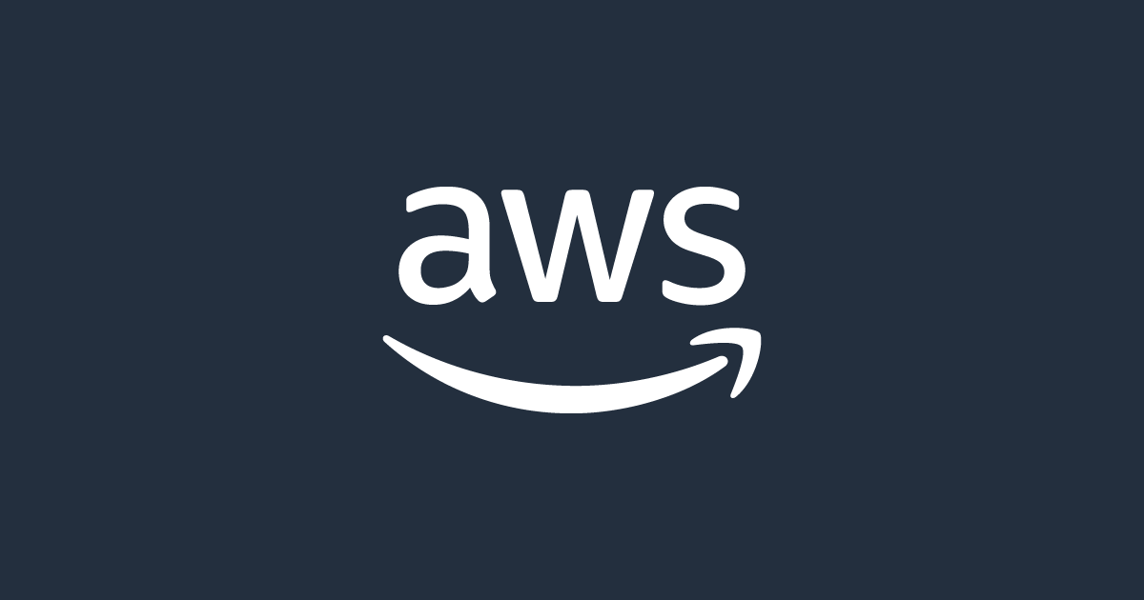
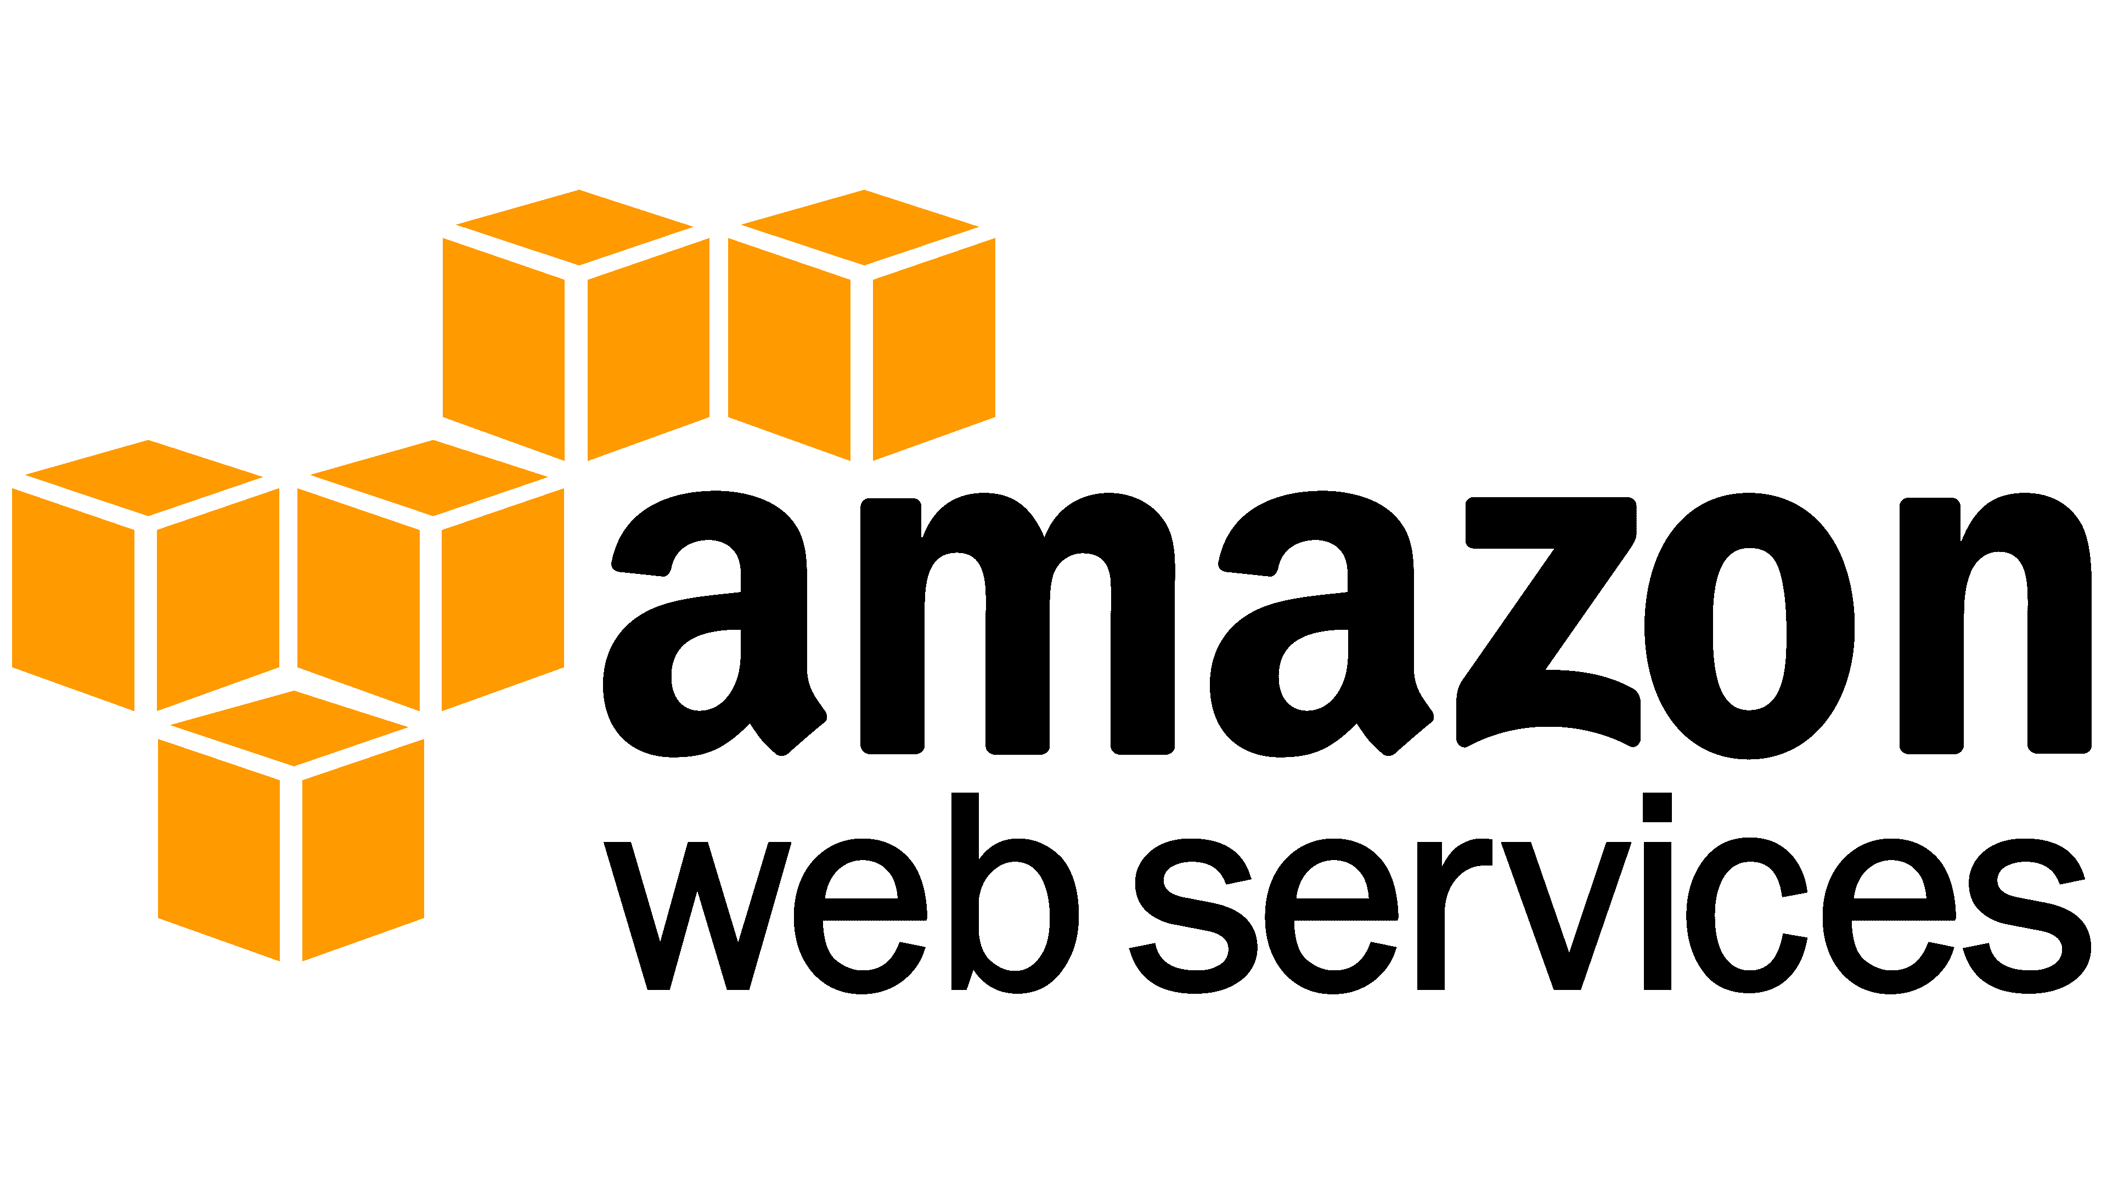
AWS PROJECT
P.Narendra
Instructor : Lavish arora
21A31A05I1

Slide 2
AWS PROJECT
Module Assignment:
Multi Branch Company Setup
Problem statement:
Company XYZ is a rapidly growing retail chain with branches in multiple cities across the country. As the company expands, it faces challenges in managing its IT infrastructure efficiently and securely. The IT team is tasked with migrating the company'son-premises servers and applications to the cloud to improve scalability, reliability, and cost-effectiveness.
Retail chain with branches in multiple cities
Currently operates on-premises servers and applications.
Facing challenges in managing IT infrastructure as the company expands.
Goal: Migrate to the cloud to improve scalability, reliability, and cost
Prerequisities:

Slide 3
AWS networking infrastructure
Create VPCs
Attach Internet Gateway
Create Subnets
Configure Route Tables
Subnet Association
Enable Internet Access
Set Up NAT Gateway
Update Route Tables for NAT
Create EC2 instance
Implement Security Measures
Deploy Transit Gateway
Connect Transit Gateway to Route Tables
Update route table with transit gateway

Slide 4
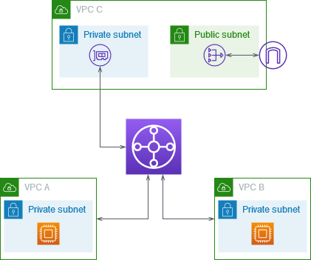
Architecture diagrams:
They help in understanding the structure of the infrastructure, including VPCs, subnets, internet gateways, NAT gateways, route tables, security groups, and connectivity patterns such as those facilitated by Transit Gateway.
AWS
NAT
Gateway
Transit
Gateway

Slide 5
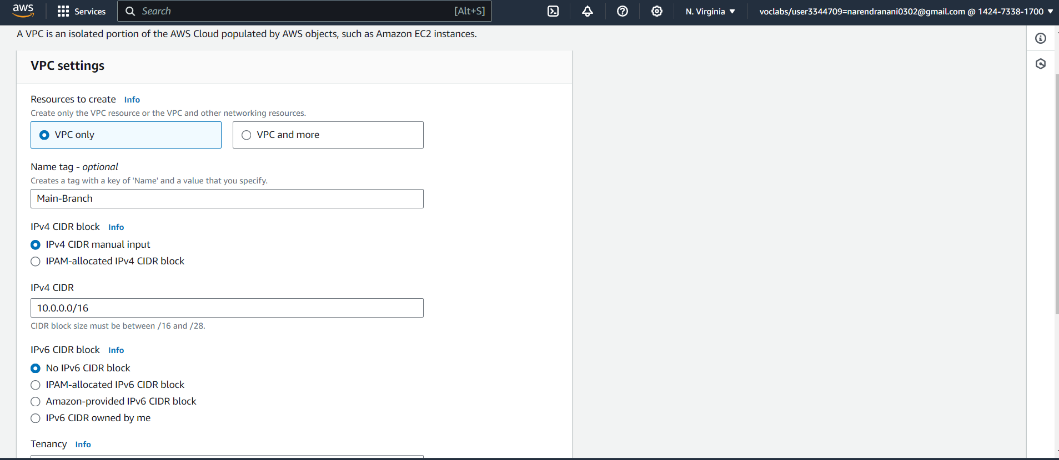
Step 1.Create VPCs (Main branch)
Open AWS account, search VPC in search bar and click on VPC
Click on create VPC, select VPC only and entre IPv4 and click create VPC.

Slide 6
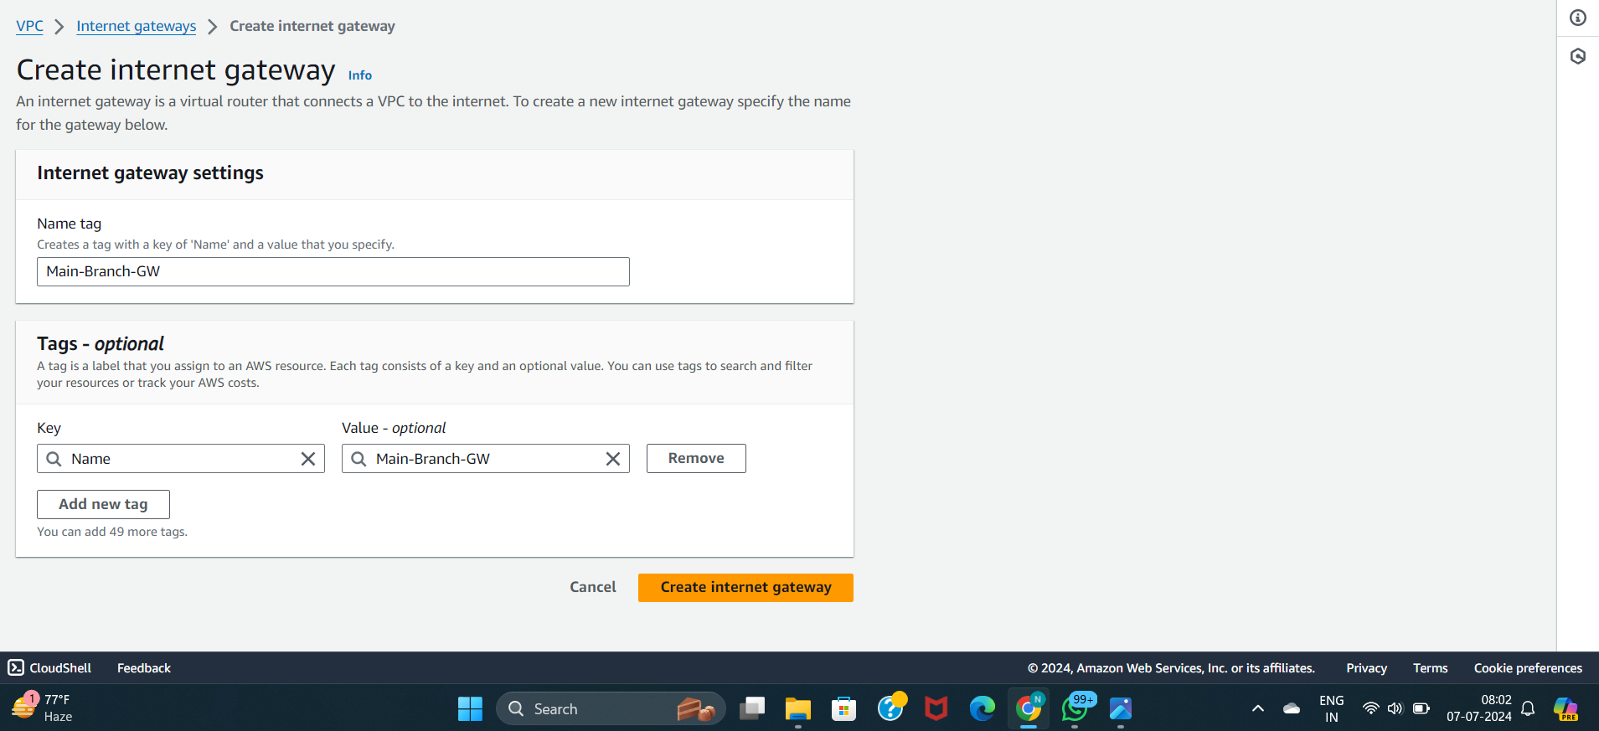
Step 2:Attach Internet Gateway (Main-Branch-GW)
This step allows your VPC resources (in public subnets) to access the internet and vice versa. Make sure to associate the Internet Gateway with the correct route tables
Click on Create internet gateway, give name to it and create internet gateway

Slide 7
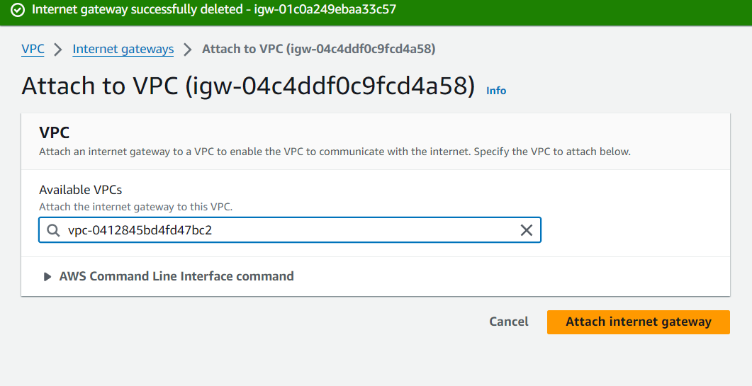
Now, Attach this internet gate to your custom VPC
Step 3: Create Subnets
Create a Public Subnet and Private Subnet in your Custom VPC
Public Subnet(Main-branch-public-subnet):A public subnet is a portion of a computer network that is accessible from the Internet, meaning it has a public IP address that can be reached by anyone on the Internet. In a public subnet, resources like web servers, email servers, and other services that need to be publicly accessible are typically deployed.

Slide 8
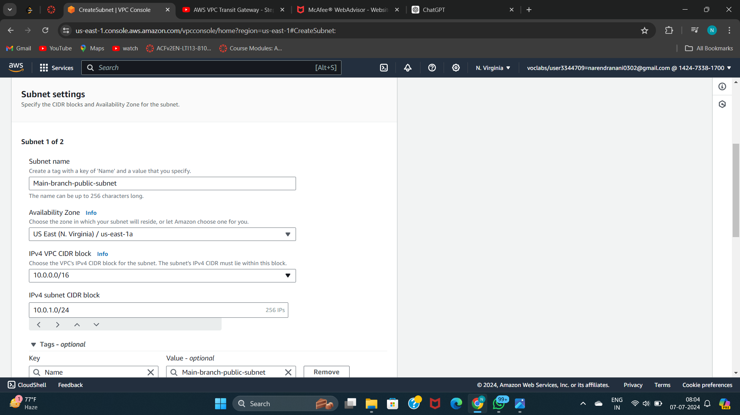
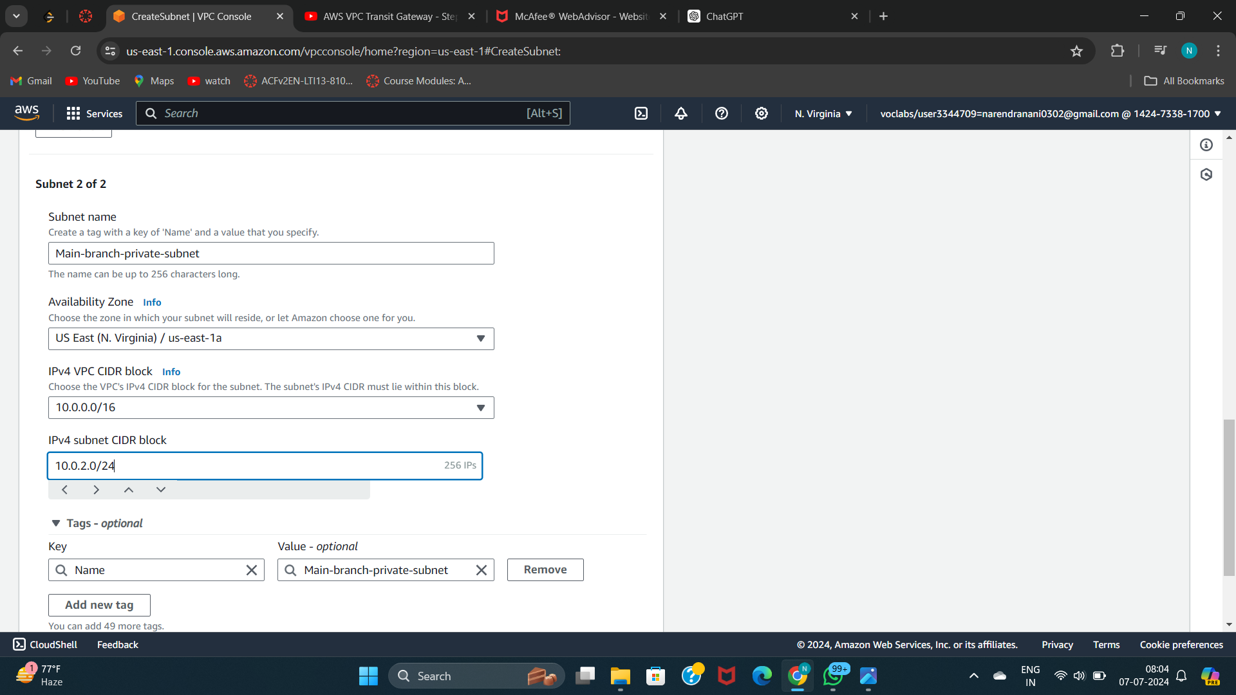
Private Subnet (Main-branch-public-subnet): A private subnet refers to a subnet within an AWS Virtual Private Cloud (VPC) that does not have a direct route to the internet. Instances (virtual machines or services) launched within a private subnet typically do not have public IP addresses assigned to them and cannot communicate directly with the internet.
Click create subnet

Slide 9
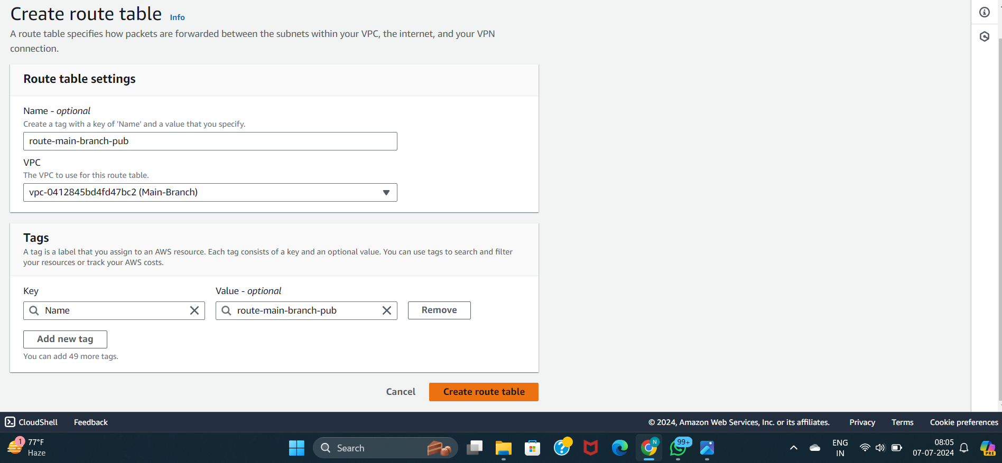
Step 4: Configure Route Tables
A route table in the context of AWS (Amazon Web Services) refers to a fundamental component of the networking infrastructure within a Virtual Private Cloud (VPC). It is used to determine where network traffic is directed based on its destination.
Route table(route-main-branch-pub) for the public subnet

Slide 10
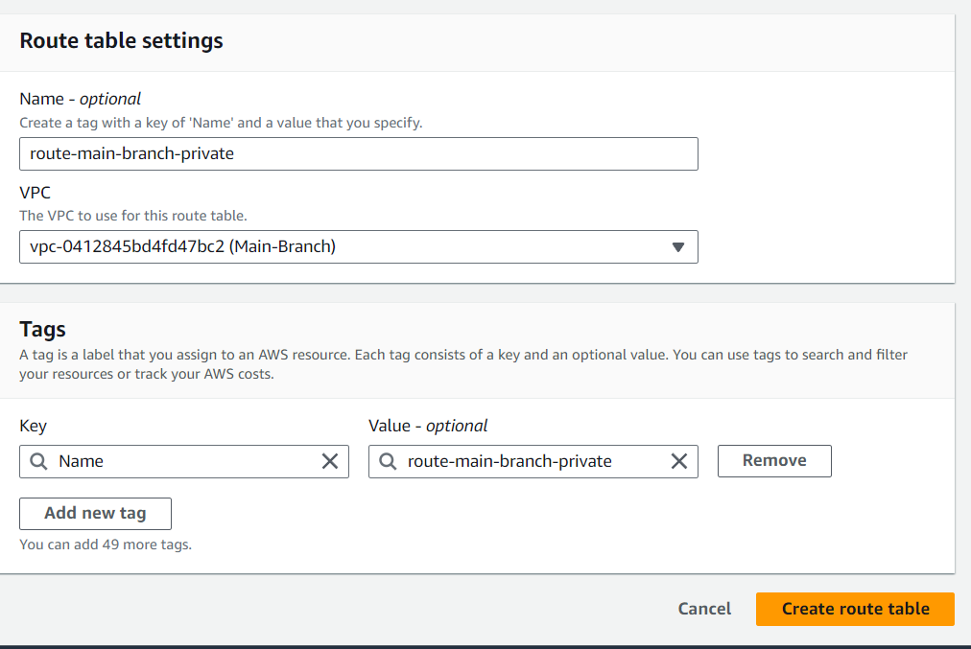
Route table(route-main-branch-private) for the public subnet
Click create route table

Slide 11
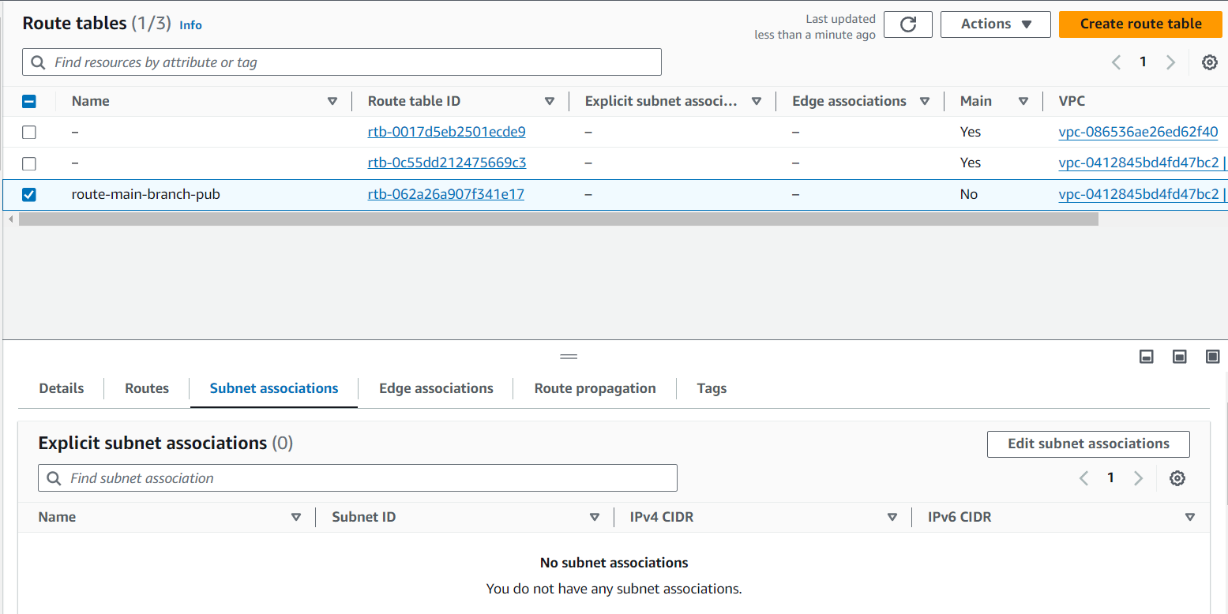
Step 5: Subnet Association
Click route table
Click create route table that we want to associate subnet
Bottom down click on subnet association

Slide 12
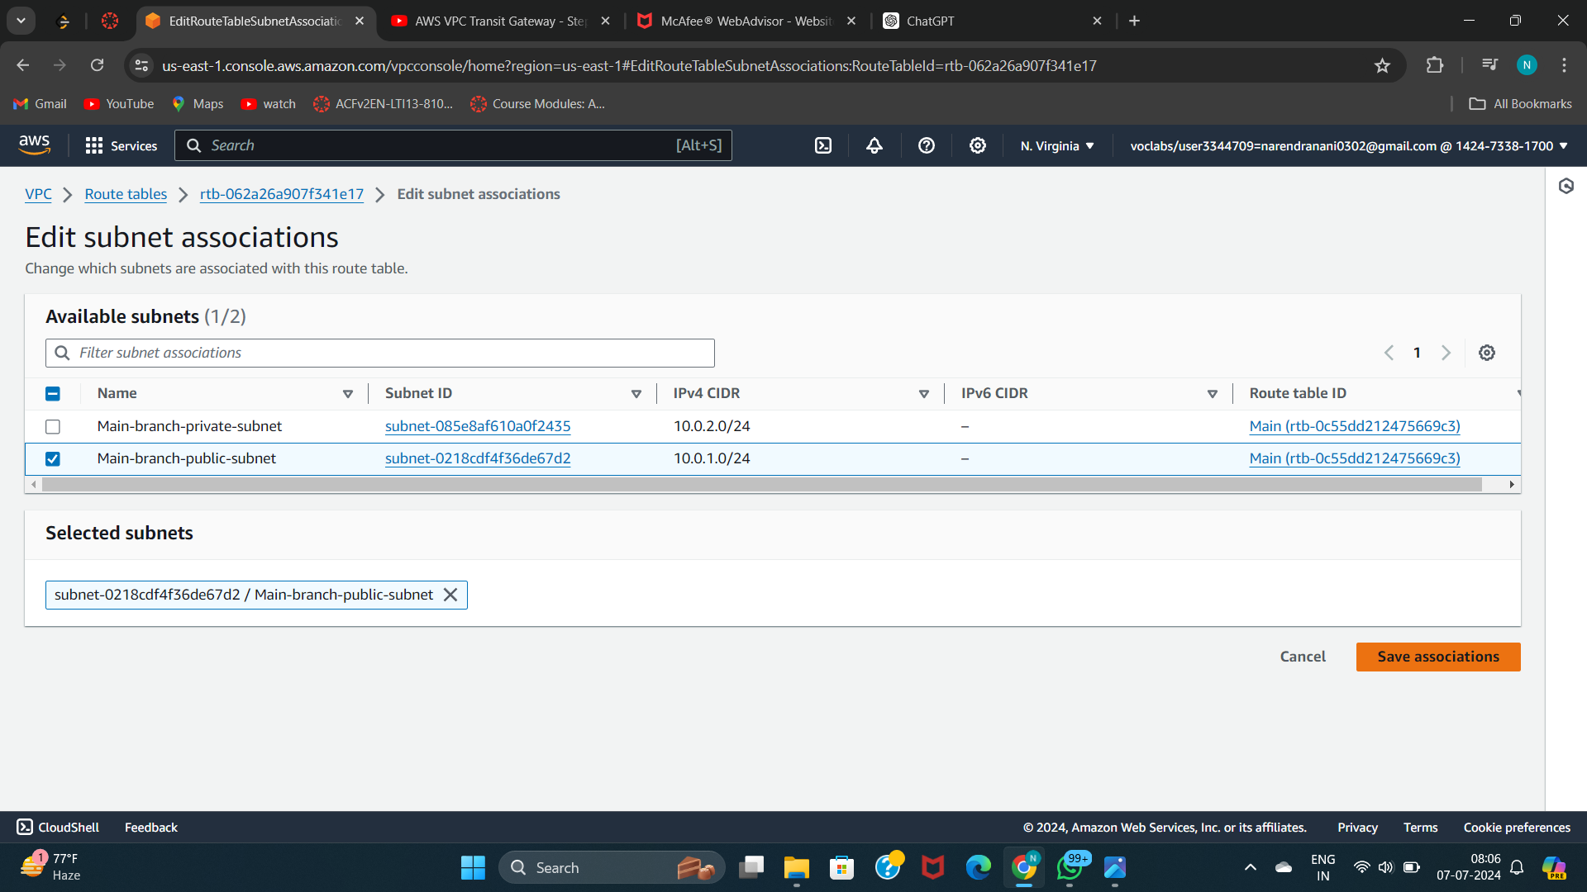
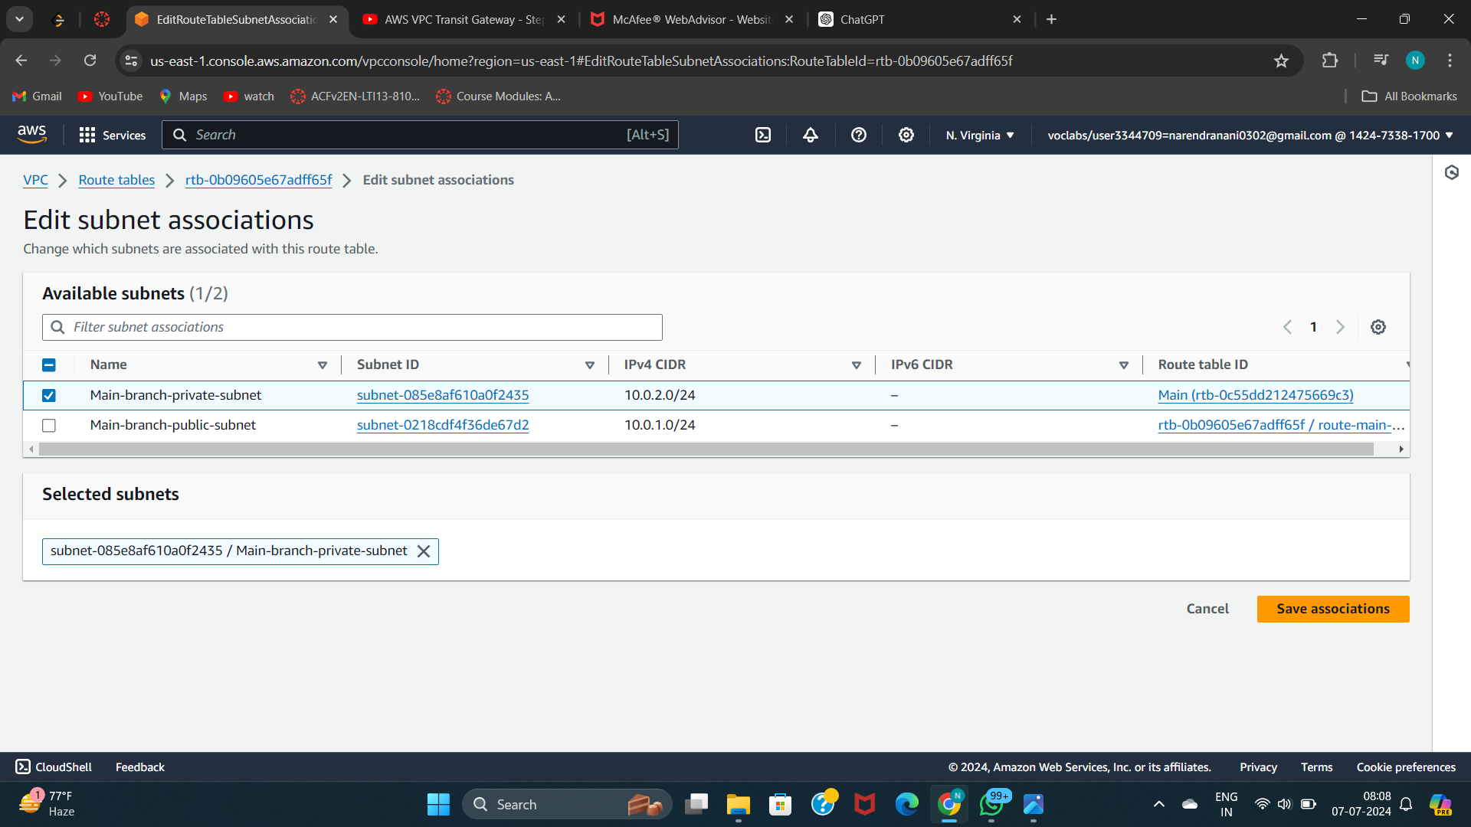
Add the subnet that wants to be associated to the route table
In the way associate the private subnet to the route table

Slide 13
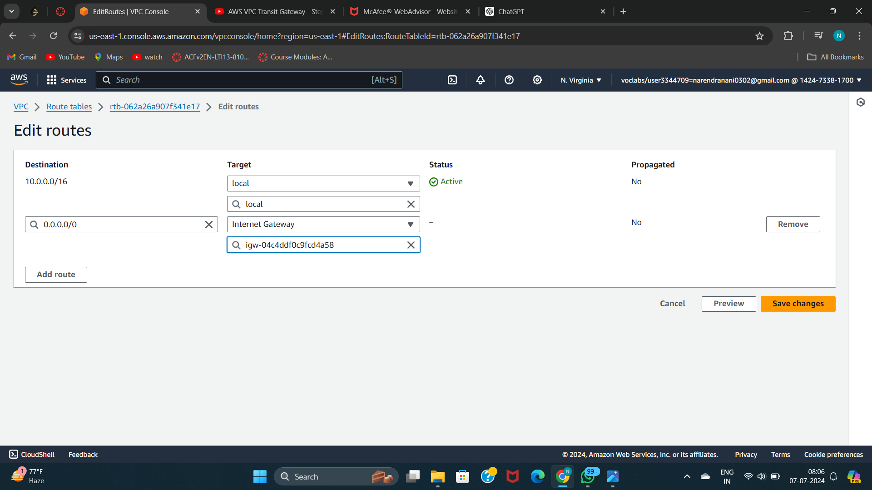
Step 6: Enable Internet Access
Click add route
Click on edit route
Add 0.0.0.0/0 so that it can be accessed by everyone and attach it to the Internet Gateway to get internet access
Click save changes
Internet access is restricted to public subnets in AWS VPCs, achieved through routes to an Internet Gateway and assignment of public IP addresses. Private subnets maintain isolation from the internet by lacking direct access, ensuring internal resources remain secure and private within the VPC architecture.
So we only add internet access to the public subnet.

Slide 14
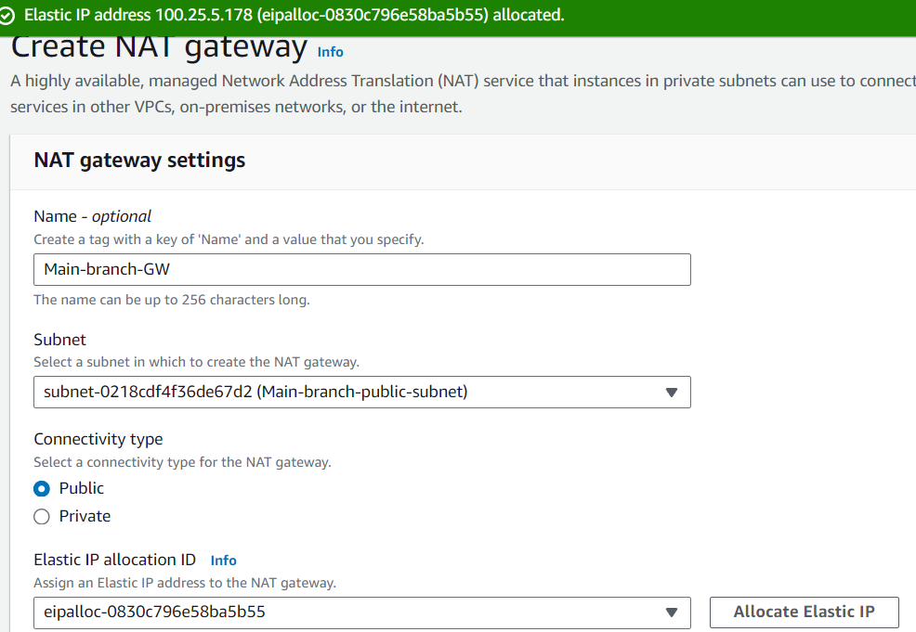
Step 7: Set Up NAT Gateway
A NAT Gateway in AWS enables instances within private subnets to initiate outbound internet traffic while keeping them inaccessible from the internet. It acts as a managed service that translates outbound traffic from instances' private IP addresses to a public IP address, facilitating secure connectivity without exposing internal resources directly to external networks.
Public subnets in AWS VPCs allow instances direct internet access via an Internet Gateway, using public IP addresses for communication. In contrast, private subnets lack direct internet access, relying on NAT Gateways or NAT instances in public subnets for outbound connectivity while keeping internal resources isolated from the internet for enhanced security.
Open NAT gateway
Click create NAT gateway
Allocate the elastic IP
Create NAT gateway

Slide 15
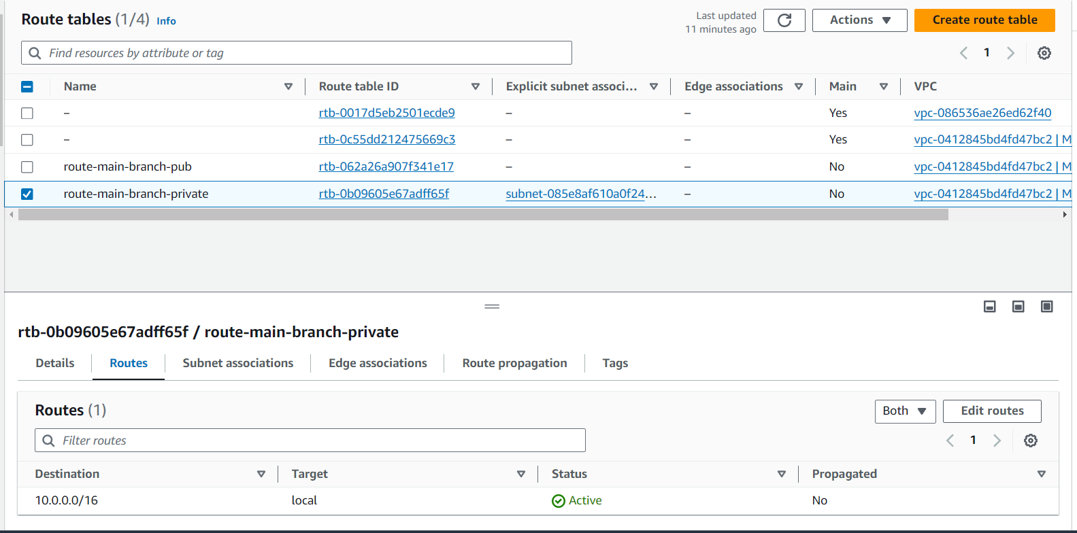
Step 8: Update Route Tables for NAT
A NAT Gateway in AWS is attached to a route table in order to direct outbound traffic from private subnets to the NAT Gateway for internet access. Here's why it's attached:
Open route table
Select the route table which is assigned to the private subnet
Go to routes
Click on edit routes

Slide 16

Click on add route
Add 0.0.0.0/0 and select the NAT gateway option form the list
Add the NAT gateway which is created in the private subnet
Step 9: Create EC2 instance for subnet
An EC2 instance in AWS (Elastic Compute Cloud) refers to a virtual server that you can launch and manage within your AWS environmen
An EC2 instance in AWS is a virtual server that you can rent and run in the cloud, offering scalable compute capacity with various configurations and operating systems to suit different application needs.

Slide 17
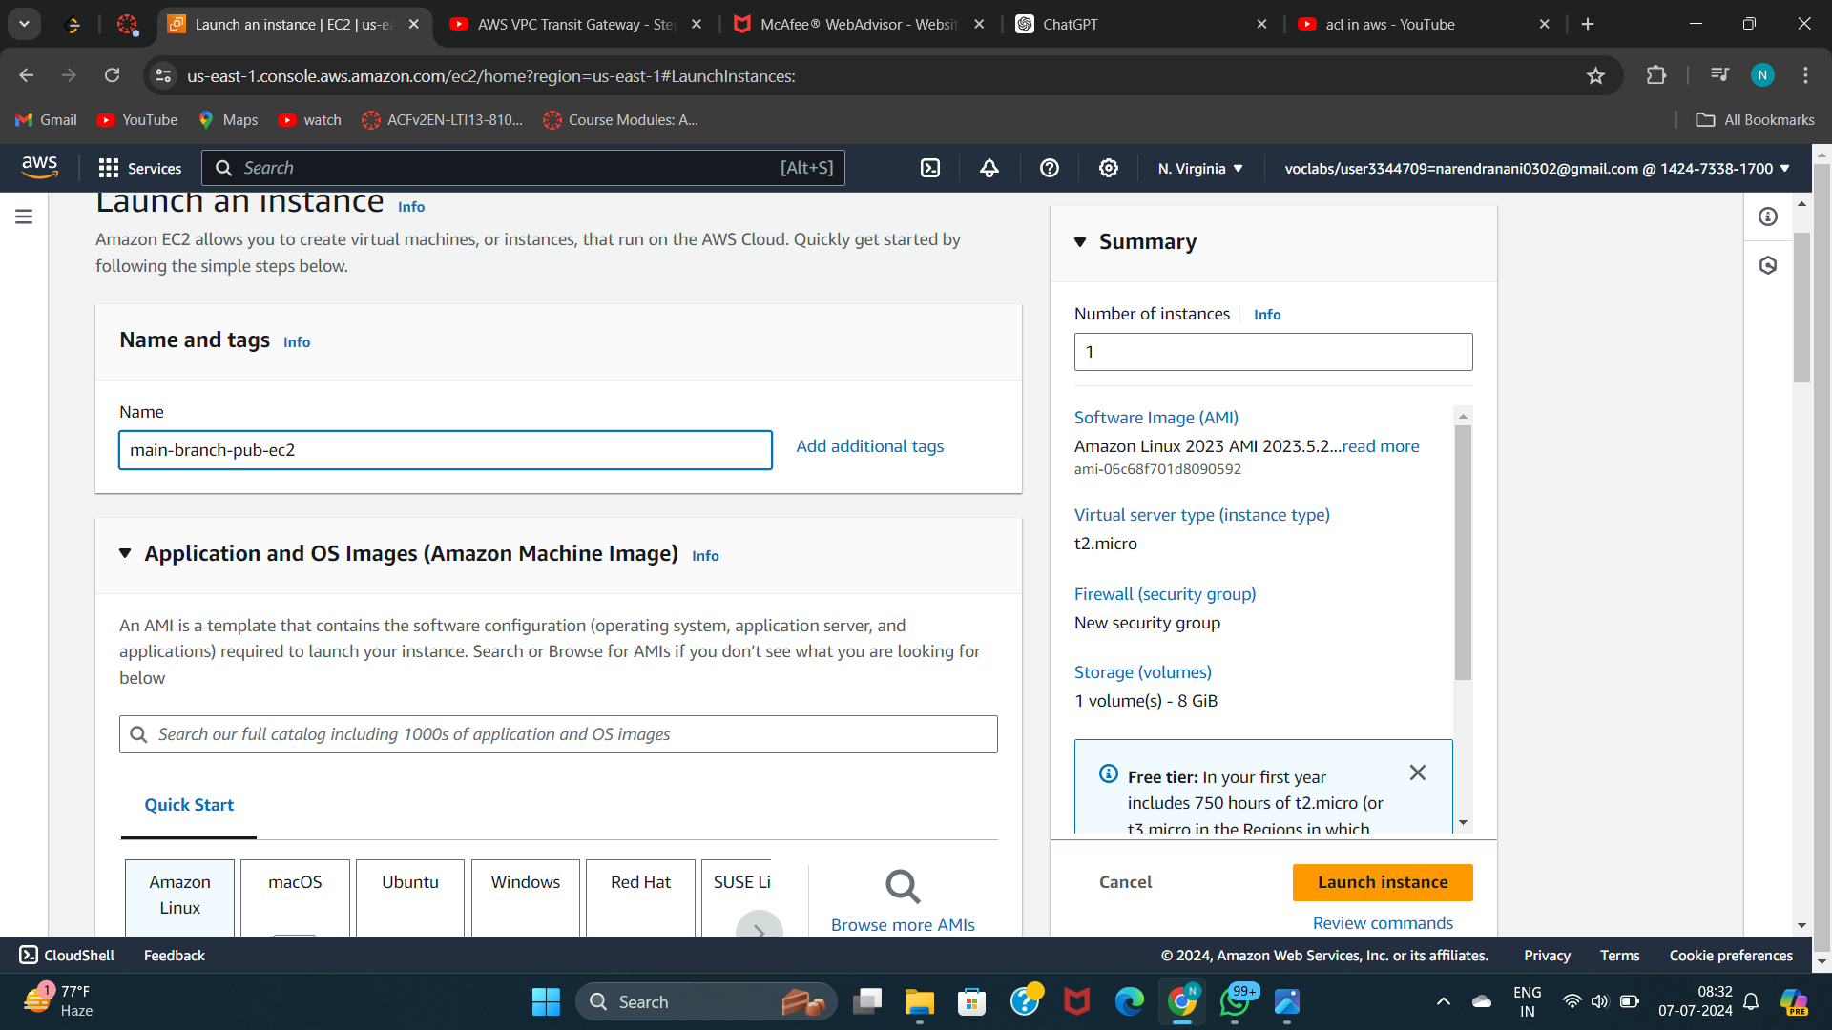
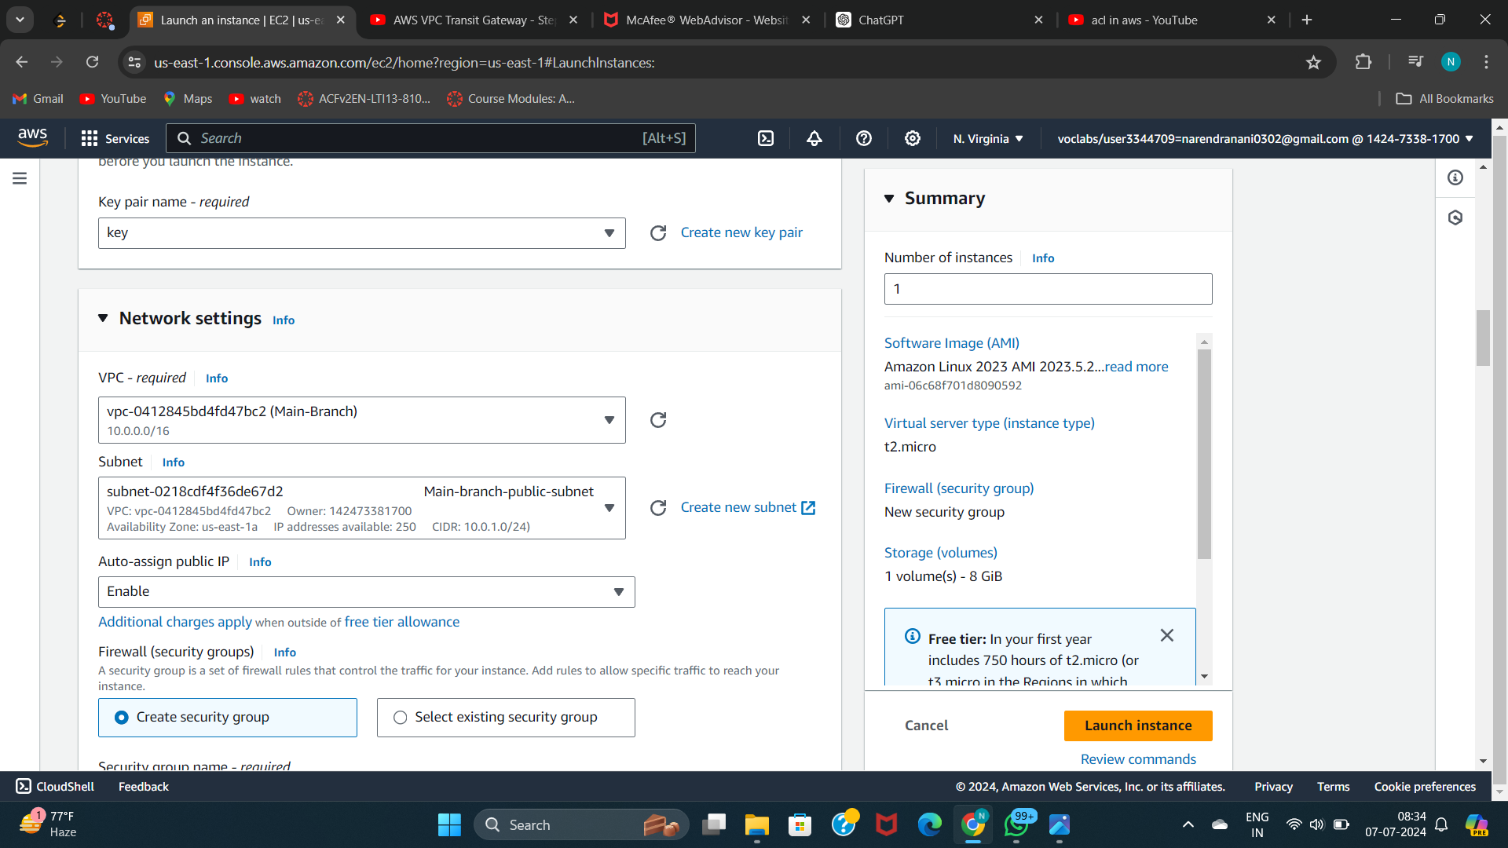
Launch EC2 Instance
Configure Instance Details like storage and OS
add/create key pair
Add VPC that to be associated
Add subnet where we want to create ec2
Enable Auto-assign public IP to get public IP address

Slide 18
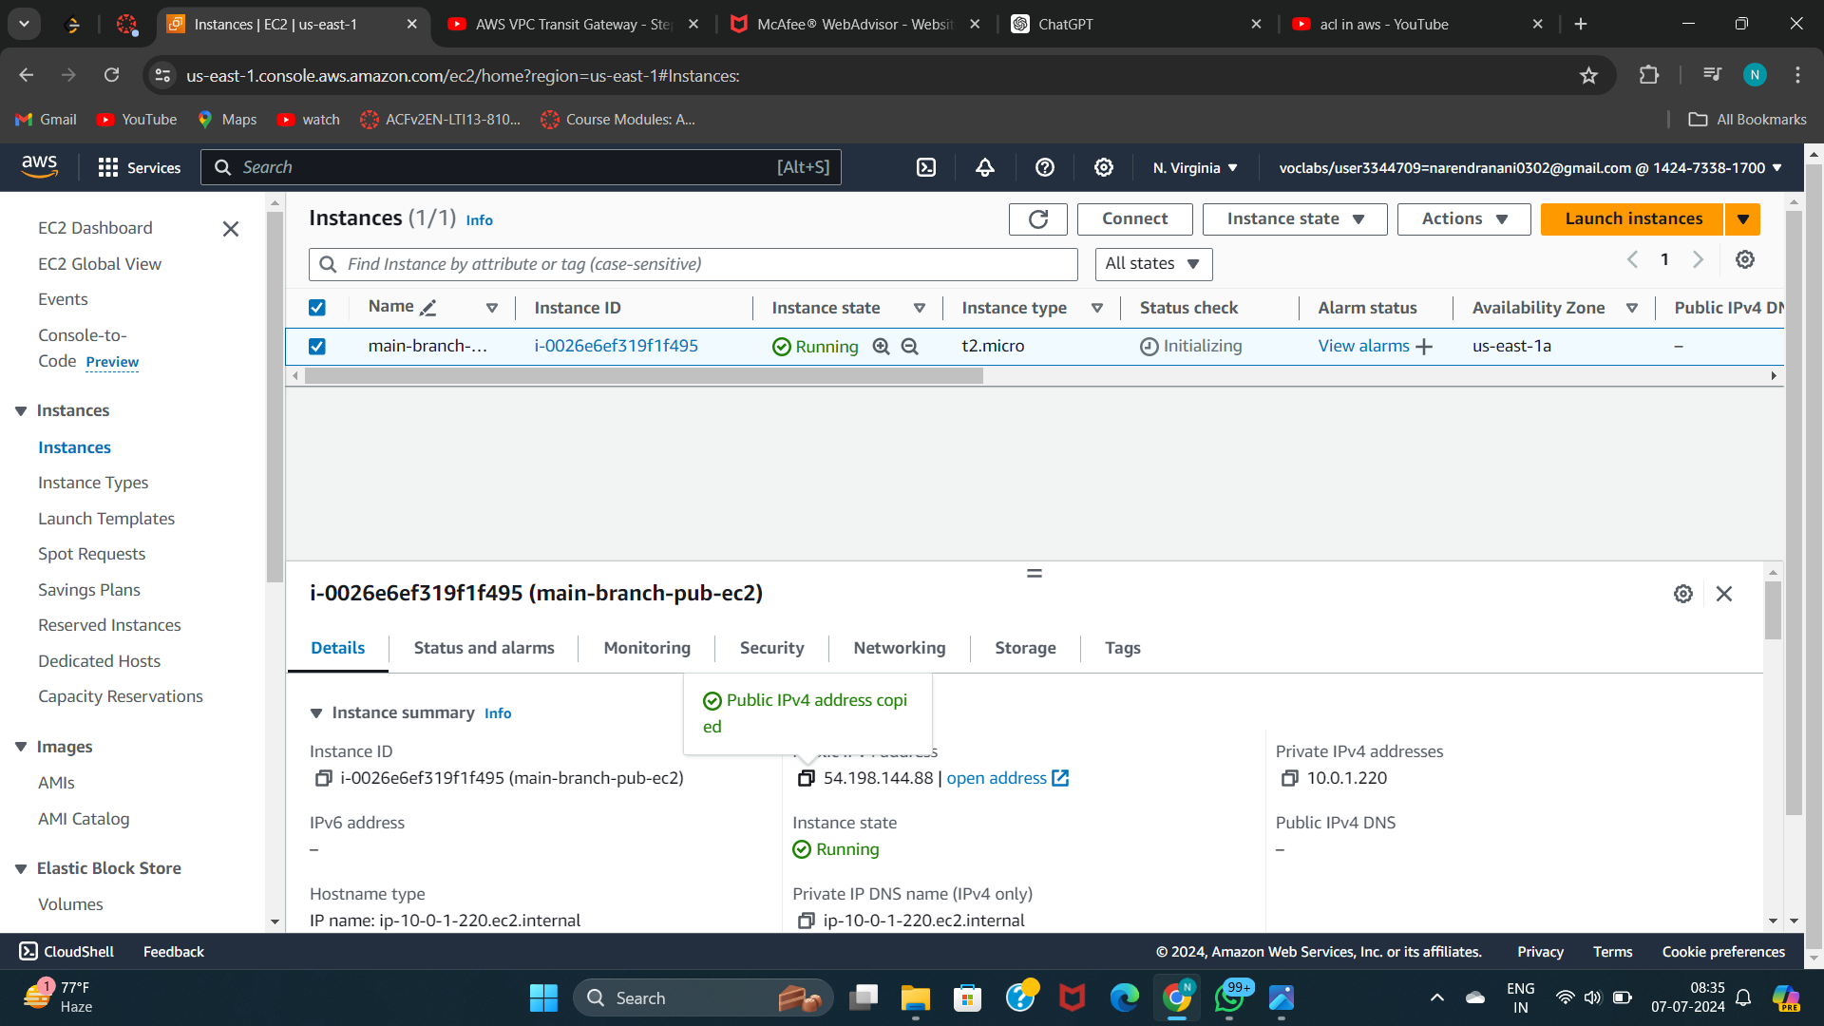
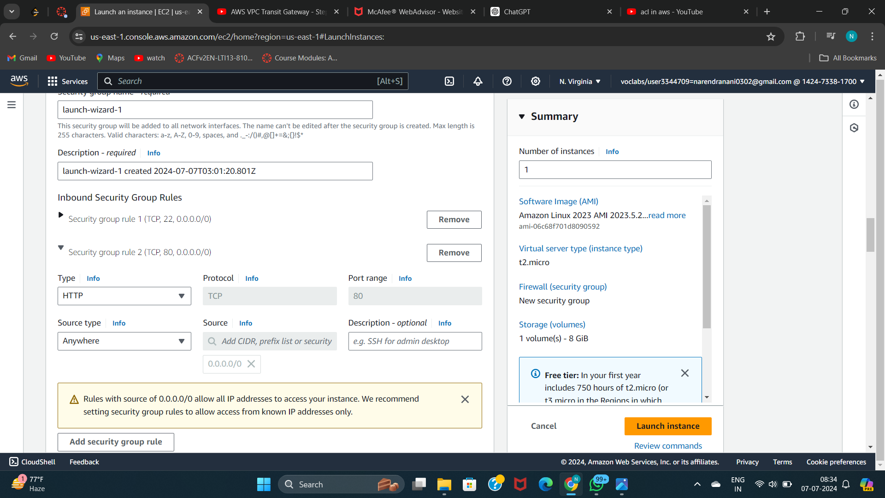
Add the security group for inbound traffic
Select the required inbound type to allow traffic
Click on launch instance
In the same way create necessary ec2 instances according to the requirement

Slide 19
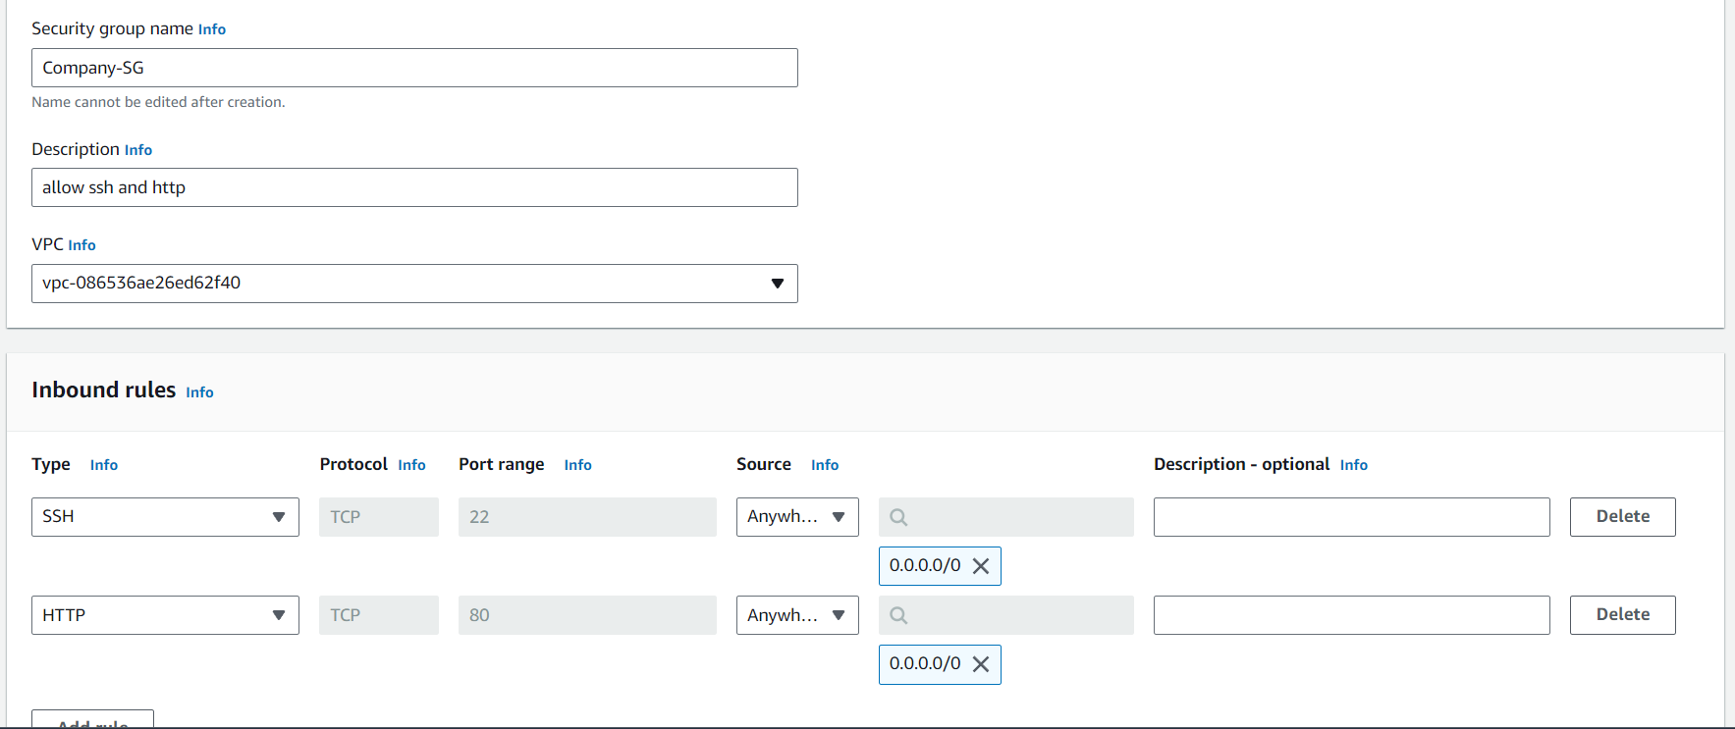
Step 10: Implement Security Measures
There multiple security prociders I want to add the security group for the inbound traffic
A security group in AWS is a fundamental component of network security that acts as a virtual firewall for controlling inbound and outbound traffic to AWS resources. It operates at the instance level (i.e., applies to one or more instances) and provides stateful filtering of traffic, meaning it tracks the state of connections and allows response traffic to return.
Add inbound rules we can to give access to

Slide 20
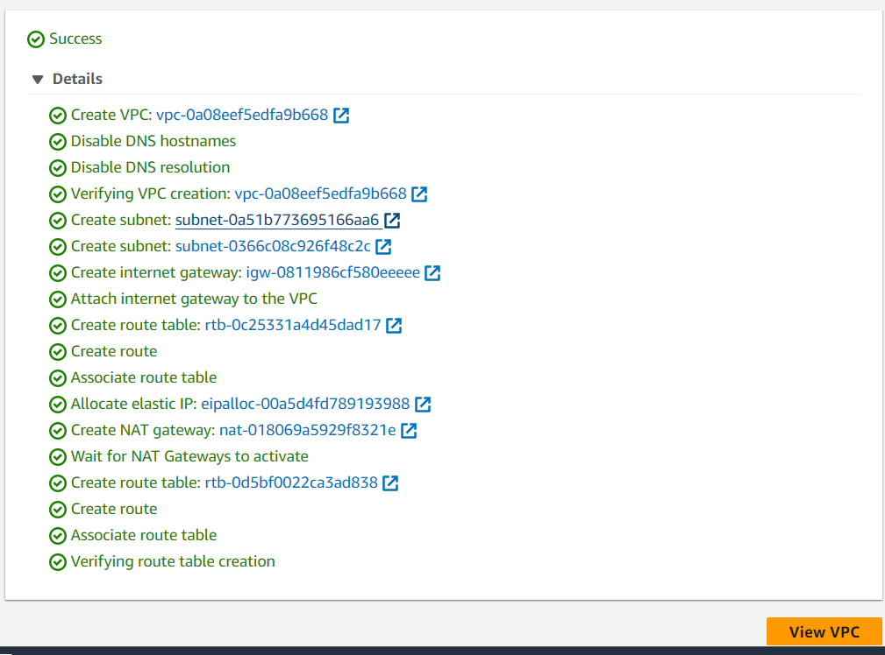
Follow the same 1 – 10 steps to create Branch-A and Branch-B
There is also another method for creating VPC, subnet, route table, internet gateway, NAT gateway easily.
Open VPC dashboard
Create VPC
Click on VPC and more
Fill the details according the requirement
Click on launch instance

Slide 21
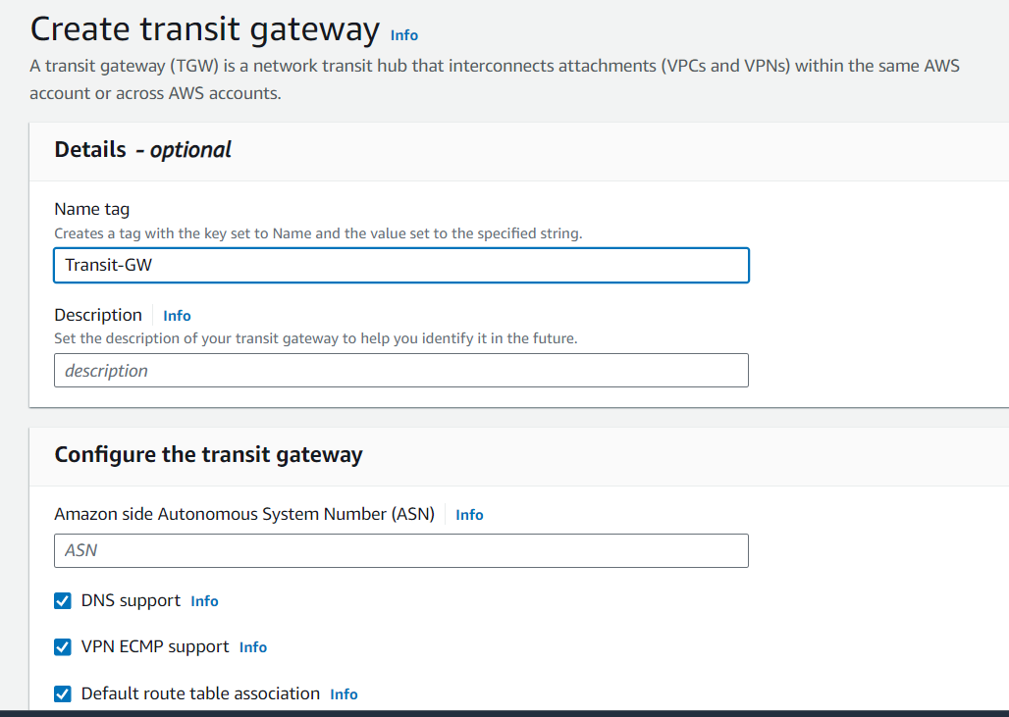
Steps 11:Deploy Transit Gateway
A Transit Gateway in AWS is a fully managed service that acts as a hub for connecting multiple virtual private clouds (VPCs) and on-premises networks. It simplifies network architecture by providing a centralized gateway that allows for efficient and scalable interconnectivity between different networks and AWS accounts.
Transit Gateways support hub-and-spoke and full-mesh network architectures, enabling organizations to easily scale and manage their network traffic across diverse environments while maintaining consistent security and compliance policies.
Open VPC dashboard
Select transit gateway
Click on create transit gateway
Add name
Click on launch transit gateway

Slide 22
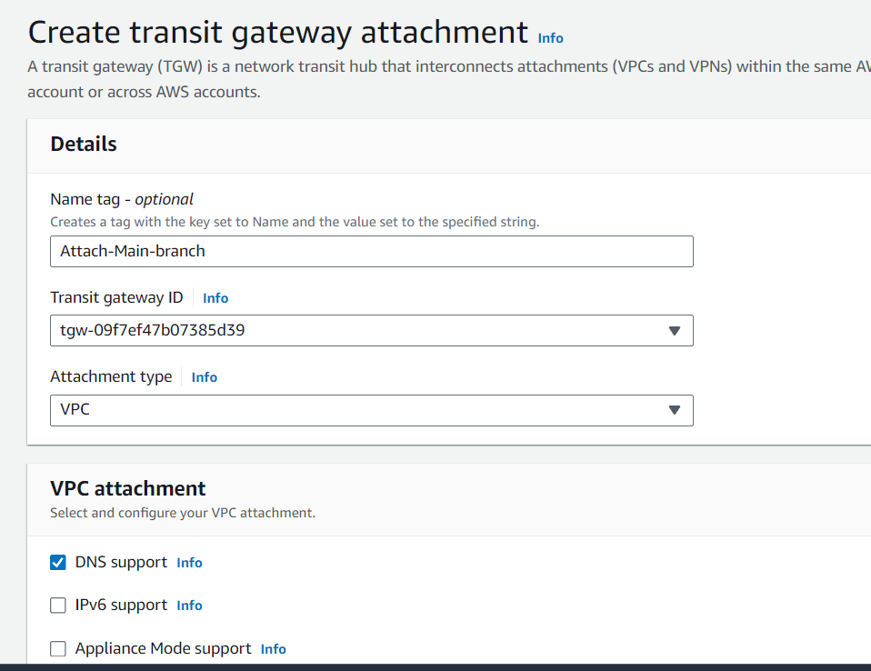
Step 12:Create Transit Gateway attachment
Connecting a Transit Gateway to route tables in AWS involves configuring route propagation or manually adding routes to direct traffic through the Transit Gateway.
Connecting VPCs via Transit Gateway allows for simplified and scalable interconnectivity between multiple virtual private clouds (VPCs) within AWS.
Navigate to Transit Gateway Console
Click transit gateway attachment
Attach transit gateway
Attachment type - VPC

Slide 23
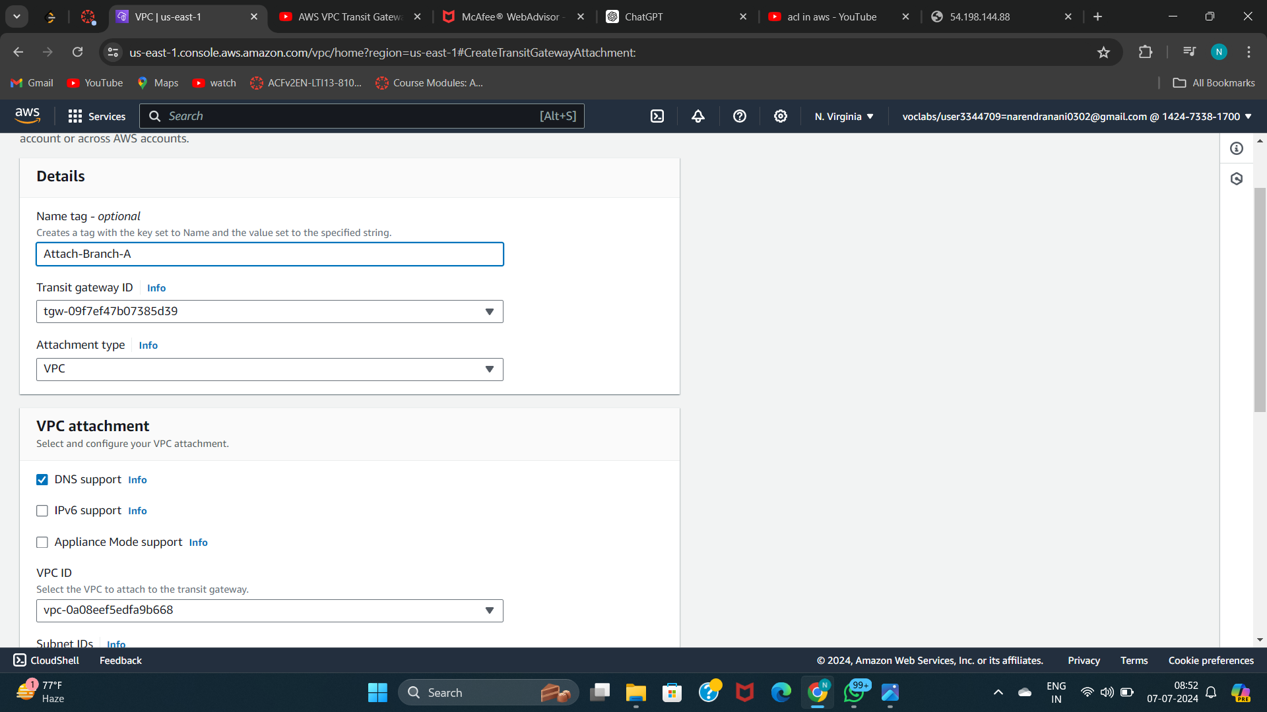
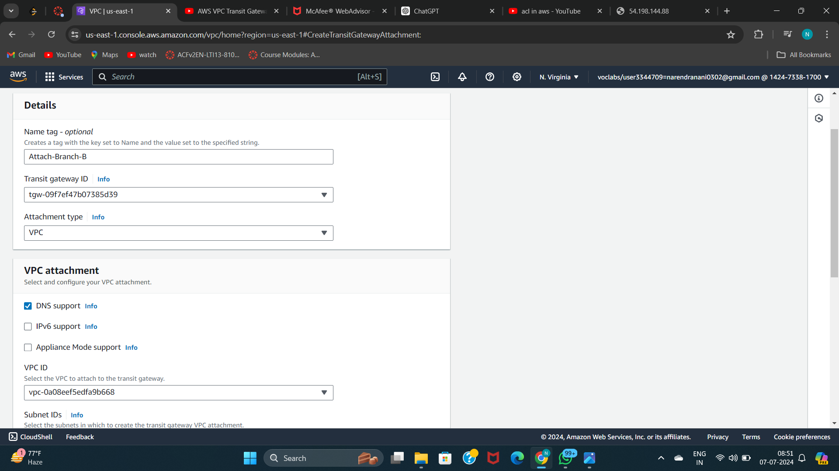
In same way create transit gateway attachment to Branch-A and Branch-B

Slide 24
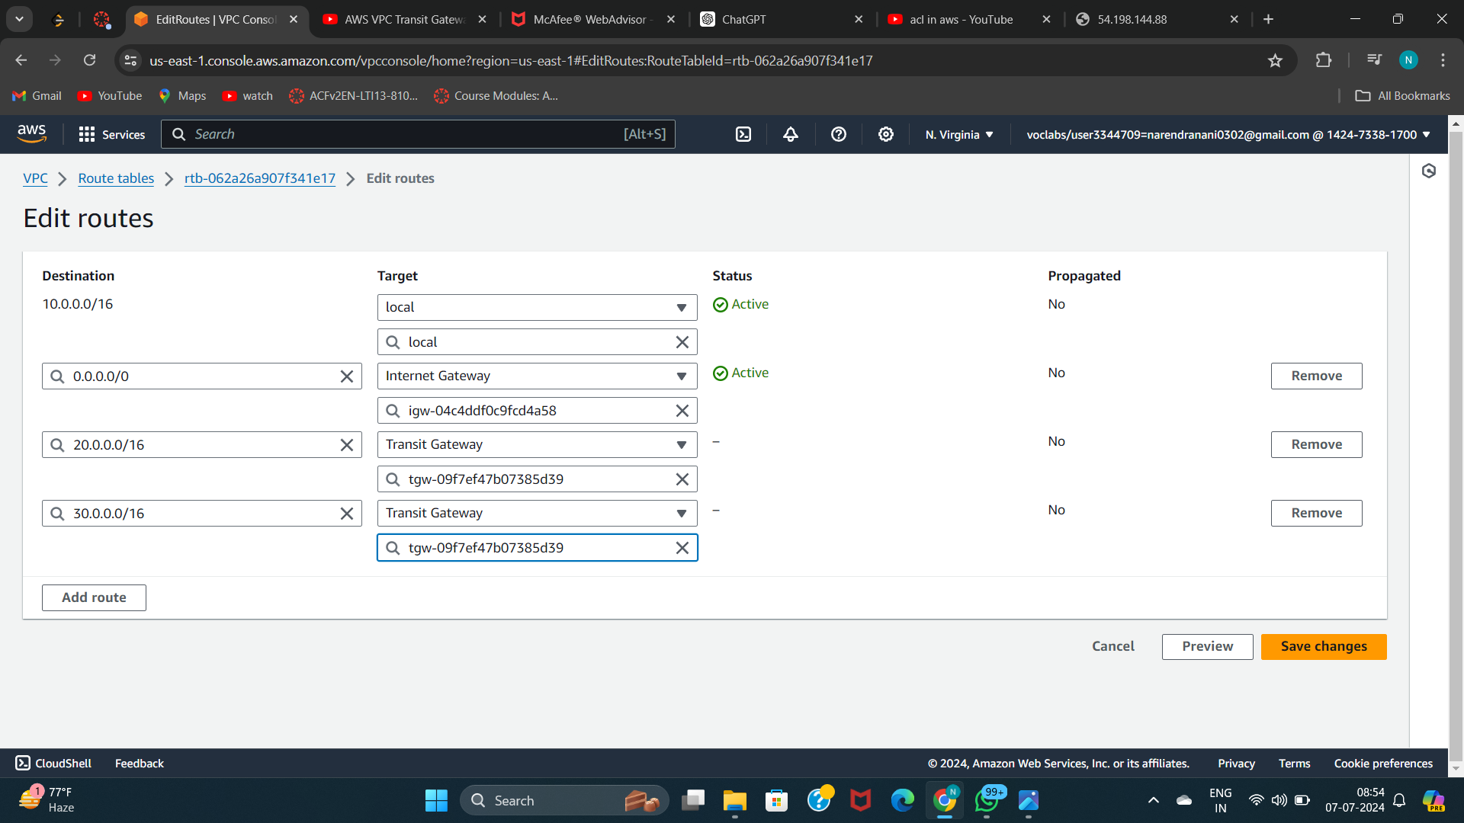
Step 13: Update route table with transit gateway
Updating route tables with Transit Gateway in AWS is essential for centralized management of network traffic across multiple VPCs and on-premises networks. It enables scalable and efficient routing by defining how traffic flows through the Transit Gateway hub.
This approach simplifies network architecture, enhances security through controlled traffic routing, and ensures reliable connectivity with built-in high availability and redundancy features.
Navigate to Route Table Management
Select Route Table
Select edit route
Add Transit Gateway Route
Specify Destination and Transit Gateway ID
Review and Save Change
In same way create transit gateway attachment to Branch-A and Branch-B

Slide 25
Conclusion
Inter-Region Connectivity: Transit Gateway enables secure communication and data sharing between the company's branches located in different AWS regions.
Scalability Across Branches: As new branches are added, Transit Gateway ensures seamless integration for sharing data and resources across the expanding network.
Security Assurance: The architecture provided by Transit Gateway ensures robust security measures are maintained, safeguarding data and resources during inter-branch communications.
Enhanced Scalability: By centralizing network management, Transit Gateway supports scalable growth without compromising on performance or reliability.
Cost Efficiency: The streamlined architecture offered by Transit Gateway contributes to cost-effective operations, optimizing resources across the company's distributed infrastructure.

